Slide 1

ESSAY WRITING
Thesis to a coherent essay
Concepts • Models • Practice • Peer review

Slide 2
Warm-up: What makes writing convincing?
A
B
“Social media is bad.”
“Unregulated social media use can harm students’ concentration by interrupting sustained reading and study.”
Which statement gives a reader more to think about—and why?

Slide 3
What is an essay?
An essay is a structured piece of writing that develops an idea, explains a subject, narrates an experience, or argues a position.
Purpose: inform, explain, reflect, narrate, or persuade.
Audience: the reader whose knowledge and expectations matter.
Focus: one controlling idea or question.
Development: reasons, examples, facts, analysis, or details.

Slide 4
Four common essay purposes
Genres can overlap; purpose determines the choices
NARRATIVE
DESCRIPTIVE
Tell a story or experience.
Example: A day that changed my life.
Create a vivid impression.
Example: A place I remember.
EXPOSITORY
ARGUMENTATIVE
Explain or analyze.
Example: Causes of climate change.
Defend a claim with reasons and evidence.
Example: Should university education be free?

Slide 5
The three-part architecture
1. INTRODUCTION
Context + focus + thesis
2. BODY
Main points + evidence + analysis
3. CONCLUSION
Synthesis + final implication
The number of paragraphs depends on the task.
What should not be included in a conclusion?

Slide 6
The introduction: orient the reader
Begin with relevant context or a compelling question.
Narrow the focus so the topic is manageable.
State the thesis clearly, usually near the end of the introduction.
Avoid sweeping claims, dictionary openings, and promises the essay cannot fulfill.
Example opening
“Universities increasingly use digital platforms to support learning. The key question is not whether technology belongs in education, but how it should be used…”

Slide 7
The thesis statement: the essay’s compass
A strong thesis is focused, arguable, and supportable
TOO BROAD
MORE EFFECTIVE
“Social media affects students.”
“Responsible use of social media can support learning by expanding access to resources and enabling peer collaboration.”
It answers the question rather than merely naming the topic.
It gives the essay a clear direction.
Its key parts can become the main points of the body.

Slide 8
Practice 1: improve the thesis
Question: Should university education be free?
Draft thesis
Your task
“Education is important.”
Make the claim specific. Add a position and two or three reasons.
Sentence frame (optional): University education should/should not be free because…

Slide 9
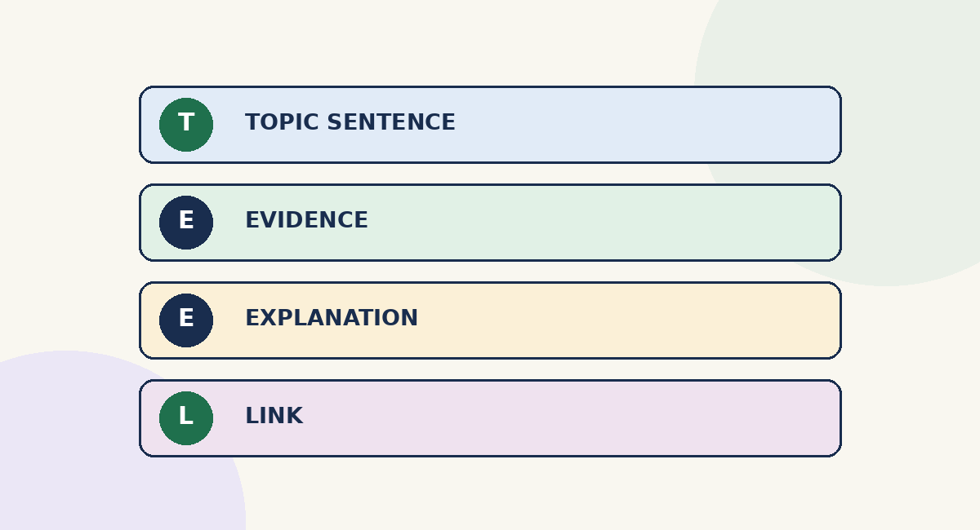
The body: one paragraph, one main job
A paragraph should develop—not merely announce—a point
Topic sentence: states the paragraph’s controlling point.
Evidence/example: gives the reader something concrete.
Explanation: shows why the evidence matters.
Link: connects the point to the thesis or next idea.

Slide 10
Model paragraph: notice the logic
Read for claim → example → explanation → link
MODEL
Social media can make educational resources more accessible to students. Online platforms allow learners to access recorded lectures, digital libraries, and discussions beyond the classroom. For example, a student who misses a lecture may review a recording and ask questions in a course forum. This flexibility can help learners revisit difficult material at their own pace. Used responsibly, social media can therefore complement formal teaching.
Underline the topic sentence.
Circle the example.
Mark the sentence that explains why the example matters.
Which is the concluding sentence?

Slide 11
Evidence is not the same as analysis
Use sources responsibly; explain their relevance
CLAIM
EVIDENCE
ANALYSIS
“Regular reading improves vocabulary.”
A credible study or a specific, relevant example.
Explain how the evidence supports the claim.
Avoid “quote dumping”: a quotation does not explain itself. Introduce it, cite it when required, and interpret it.
In academic work, use reliable sources and follow the required citation style.

Slide 12
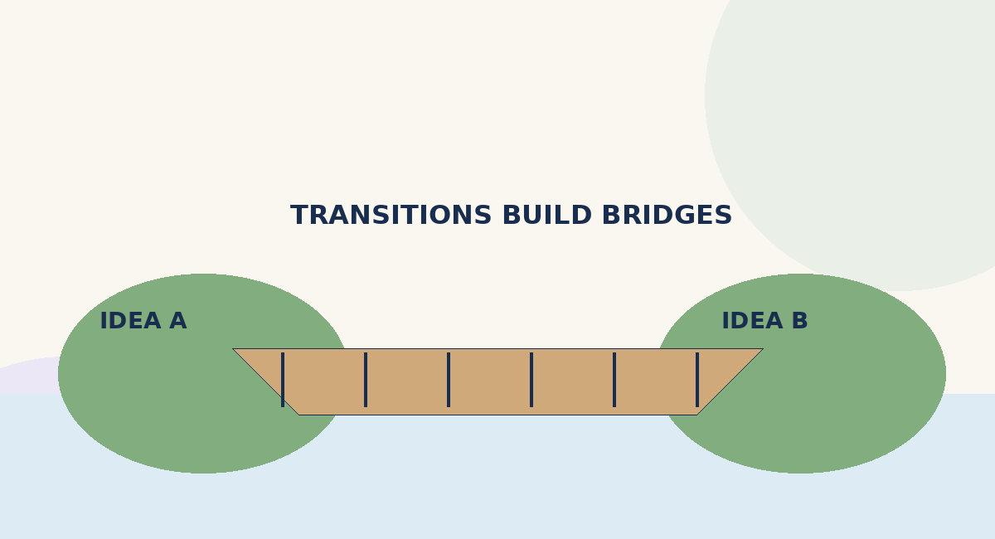
Coherence vs. cohesion
COHERENCE
COHESION
The overall logic and order of ideas make sense.
Language links sentences and ideas: reference, repetition, transitions.

Slide 13
Coherence and Cohesion
Cohesive but NOT Coherent (Flows well, but makes no sense)
I bought a car today. The car was red. Red is the color of a tomato. Tomatoes grow in the garden.
Coherent but NOT Cohesive (Makes sense, but choppy to read)
The rain was heavy. The soccer match was canceled. The players went home.
The rain was exceptionally heavy; therefore, the soccer match was canceled. Because of this disappointment, the players decided to go home early.

Slide 14
Sentence craft: clarity before complexity
Prefer precise verbs and concrete nouns.
Vary sentence length to control pace and emphasis.
Check sentence boundaries: avoid fragments and run-ons.
Place modifiers near the words they describe.
Use parallel structure for ideas of equal importance.

Slide 15
Plan before drafting: write an outline
An outline helps test the logic before writing full paragraphs
Essay question: What exactly must I answer?
Thesis: What is my central response?
Point 1: What is the strongest reason?
Point 2: What other reason or perspective matters?
Point 3: What evidence, example, or qualification is needed?
Order points by logic—not simply by the order in which they occurred to you.

Slide 16
Activity 2: build a mini-essay plan
Choose ONE prompt
Create a 5-part plan
A. Should English be the official language of Pakistan?
B. Does AI help or hinder student learning?
1 thesis
2–3 body points
1 possible counterargument
1 concluding insight
Write a one-sentence thesis.
List three points and a supporting example for each.
Choose the strongest order and explain why.

Slide 17
Stronger arguments consider another view
POSITION
COUNTERARGUMENT
RESPONSE
State your claim clearly.
Represent a reasonable opposing view fairly.
Accept a valid point or explain why your case remains stronger.
Useful language: “Critics may argue that… However, this view overlooks…”
Do not invent a weak opposing view just to dismiss it.

Slide 18
The conclusion: close the argument
Synthesize rather than repeat word-for-word
Return to the thesis in light of what the essay has shown.
Synthesize the main points; do not list them mechanically.
Explain the broader implication, significance, or next question.
Avoid new major evidence or exaggerated claims.

Slide 19
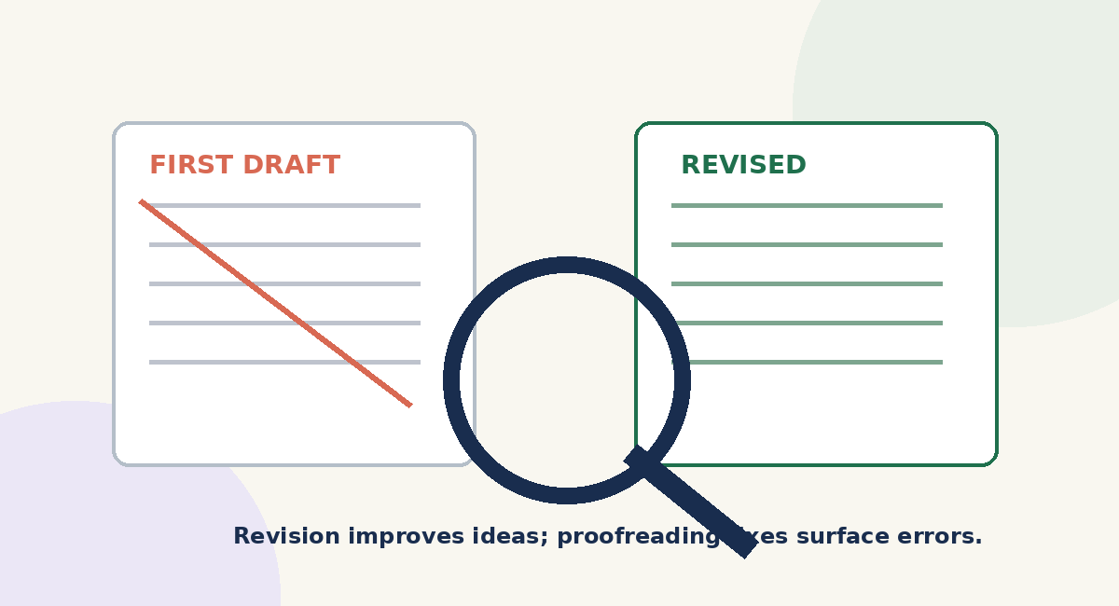
Revision and proofreading are different
REVISION
Ideas, evidence, order, paragraph unity, thesis alignment.
PROOFREADING
Grammar, punctuation, spelling, citations, formatting.
Practical rule: revise with the reader’s questions in mind; proofread slowly, one issue at a time.

Slide 20
Peer review: be specific and kind
Can I identify the thesis in one sentence?
Does each body point support the thesis?
Is there an example or evidence for each key claim?
Does the writer explain how the evidence matters?
Are the ideas in a logical order?
Where did I feel confused, unconvinced, or especially engaged?
Name one strength and one priority for revision.
Feedback formula: “I understood… / I wanted more explanation of… / One possible next step is…”

Slide 21
Frequent problems—and practical fixes
Use this as a self-editing checklist
No clear thesis
Paragraph drift
Write a one-sentence answer to the prompt.
Give each paragraph one controlling idea.
Unsupported claim
Quote dumping
Add credible evidence or a specific example.
Explain the relevance of every quotation.
Repetitive transitions
Conclusion repeats intro
Choose precise links—or let the logic speak.
Show what the argument has established.

Slide 22
Activity 3: show what you can do
Write a thesis for: “Should AI tools be allowed in university coursework?”
List two body paragraph points that would support your thesis.
Name one kind of evidence you would need.
Write one question you will ask yourself when revising.
Success looks like
A focused claim, a logical plan, and a clear link between claim and evidence.

Slide 23
Remember the writing process
Understand the task and audience.
Plan a thesis and logical sequence.
Develop paragraphs with evidence and its explanation.
Connect ideas; prioritize clarity.
Revise and proofread
Core principle: every paragraph should help the reader follow and assess your central idea.

Slide 24
References and further reading
Wren, P. C., & Martin, H. (latest available edition). High School English Grammar and Composition. S. Chand Publishing. (Use the edition assigned by your institution.)
Purdue Online Writing Lab (OWL). “Argumentative Essays,” “Developing Strong Thesis Statements,” and “Paragraphs and Paragraphing.” https://owl.purdue.edu/
Harvard College Writing Center. “Strategies for Essay Writing.” https://writingcenter.fas.harvard.edu/
UNC Writing Center. “Introductions,” “Conclusions,” and “Paragraphs.” https://writingcenter.unc.edu/
George Mason University Writing Center. “Writing an Essay.” https://writingcenter.gmu.edu/

